Slide 1
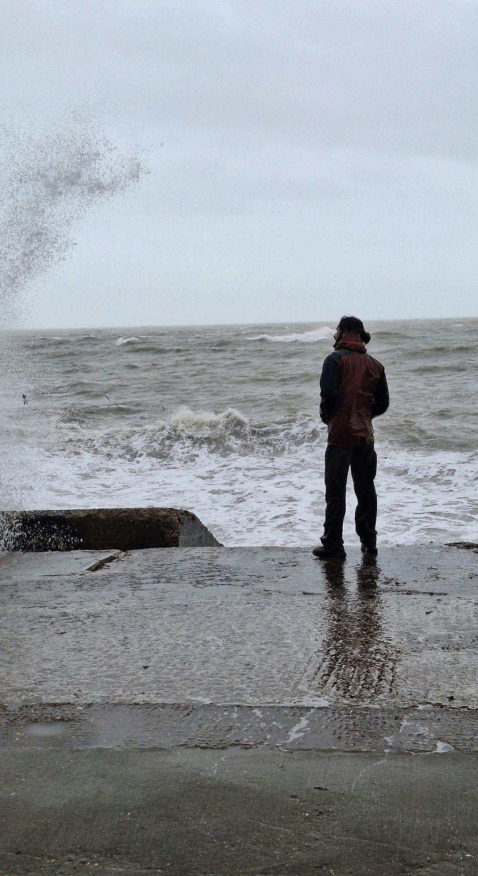

<VERSE 1>
Psalm 22:1 I groan in prayer, but help seems far away
Psalm 31:10 My life is consumed by anguish
Psalm 22:14 My heart has melted within me
Psalm 38:9 My cries are not hidden from you
Brokenhearted
2026

Slide 2
<CHORUS>
Psalm 34:18 The Lord is close to the brokenhearted, and saves the crushed in spirit
Psalm 34:19 The righteous have many troubles, but the Lord delivers them from them all
Brokenhearted
2026
Month Year

Slide 3
<VERSE 2>
Psalm 31:9 My eyes, my soul, my body waste away from grief
Psalm 38:8 Utterly spent and crushed
Psalm 38:9 Lord, you understand my heart’s desire, my cries are not hidden from you
Brokenhearted
2026

Slide 4
<CHORUS>
Psalm 34:18 The Lord is close to the brokenhearted, and saves the crushed in spirit
Psalm 34:19 The righteous have many troubles, but the Lord delivers them from them all
Brokenhearted
2026
Month Year

Slide 5
<BRIDGE>
Psalm 25:17 Relieve the troubles of my heart, rescue me from my suffering
Brokenhearted
2026
Month Year

Slide 6
<CHORUS>
Psalm 34:18 The Lord is close to the brokenhearted, and saves the crushed in spirit
Psalm 34:19 The righteous have many troubles, but the Lord delivers them from them all
Brokenhearted
2026
Month Year

Slide 7
<ENDING>
Psalm 38:9 My cries are not hidden from you
Psalm 34:18 Close to the brokenhearted, saves the crushed in spirit
Psalm 38:9 My cries are not hidden from you
Psalm 34:19 The LORD delivers, from them all
Brokenhearted
2026
Month Year

Slide 8
©2026 Awake and Renew. All Rights Reserved. Lyrics across Awake and Renew projects are curated as a precise thematic “mosaic” using verbatim excerpts and linguistic fragments from various English translations. This methodology aligns individual scriptural passages to musical meter while strictly preserving the underlying theological context. For current licensing, distribution, and usage permissions, please visit awakeandrenew.org/license.
Per publisher guidance and licensing frameworks, select phrasing, vocabulary, and cross-references from the following translations are utilized as foundational source texts to compile our lyrical arrangements:
- New King James Version (NKJV)
- New Century Version (NCV)
- New English Translation (NET)
Note: Because these specific selections are curated, adapted to meter, and integrated into a multi-translation mosaic, formal corporate legal notices for these versions are omitted from the section below at the explicit request of the rights holder.
Scripture quotations from the following translations are used by permission and are subject to the formal corporate copyright guidelines of their respective publishers:
BSB — Berean Study Bible / Berean Standard Bible - The Holy Bible, Berean Standard Bible, BSB is produced in cooperation with Bible Hub, Discovery Bible, OpenBible.com, and the Berean Bible Translation Committee. This text of God’s Word has been dedicated to the public domain. (Note: As of April 30, 2023, the BSB is now public domain and no longer requires copyright attribution, though attribution is appreciated but not required.)
CSB — Christian Standard Bible - Scripture quotations are from the Christian Standard Bible®, Copyright © 2017 by Holman Bible Publishers. Used by permission. Christian Standard Bible® and CSB® are federally registered trademarks of Holman Bible Publishers.
DARBY — Darby Translation - Scripture quotations marked (Dar) are taken from the DARBY BIBLE, published in 1867, 1872, 1884, 1890; public domain.
ESV — English Standard Version - Scripture quotations are from the ESV® Bible (The Holy Bible, English Standard Version®), copyright © 2001 by Crossway, a publishing ministry of Good News Publishers. Used by permission. All rights reserved.
GB — Geneva Bible - Scripture quotations marked (Geneva) are taken from the Geneva Bible, 1560/1599. Public domain.
GNT — Good News Translation - Scripture quotations marked (GNT) are from the Good News Translation in Today’s English Version – Second Edition Copyright © 1992 by American Bible Society. Used by Permission.
GWT — GOD’S WORD Translation - Scripture quotations marked (GW or GWT) are taken from GOD’S WORD®. © 1995, 2003, 2013, 2014, 2019, 2020 by God’s Word to the Nations Mission Society. Used by permission.
HCSB — Holman Christian Standard Bible - Scripture quotations are from the Holman Christian Standard Bible®, Copyright © 1999, 2000, 2002, 2003, 2009 by Holman Bible Publishers. Used by permission.
JPS 1917 — JPS Tanakh - Scripture quotations marked (JPS 1917) are taken from the Holy Scriptures According to the Masoretic Text, Jewish Publication Society, 1917. Public domain.
KJV — King James Version - Scripture quotations marked (KJV) are taken from the KING JAMES VERSION, public domain. (Note: The KJV is public domain in the United States and most countries, but is still under Crown copyright in the United Kingdom.)
LEB — Lexham English Bible - Scripture quotations are from the Lexham English Bible, copyright © 2012 Logos Bible Software. Lexham is a registered trademark of Logos Bible Software.
NASB — New American Standard Bible - Scripture quotations taken from the New American Standard Bible® (NASB®), copyright © 1960, 1962, 1963, 1968, 1971, 1972, 1973, 1975, 1977, 1995, 2020 by The Lockman Foundation. Used by permission. www.lockman.org
NLT — New Living Translation - Scripture quotations marked (NLT) are taken from the Holy Bible, New Living Translation, copyright © 1996, 2004, 2015 by Tyndale House Foundation. Used by permission of Tyndale House Publishers, Inc., Carol Stream, Illinois 60188. All rights reserved.
NRSV — New Revised Standard Version - Scripture quotations are from the New Revised Standard Version Bible, copyright © 1989 National Council of the Churches of Christ in the United States of America. Used by permission. All rights reserved.
RSV — Revised Standard Version - Scripture quotations are from the Revised Standard Version of the Bible, copyright © 1946, 1952, and 1971 by the Division of Christian Education of the National Council of the Churches of Christ in the United States of America. Used by permission. All rights reserved worldwide.
Tanakh — JPS Tanakh - Scripture quotations marked (Tanakh) are taken from the TANAKH: The Holy Scriptures. Copyright © 1985, 1999 by the Jewish Publication Society. All rights reserved. Used by permission.
WEB — World English Bible - Scripture quotations marked (WEB) are taken from the World English Bible, public domain.
Brokenhearted
2026
Month Year

