Slide 1




<VERSE 1>
Isaiah 59:14 Justice is driven back; righteousness stands far off; truth has stumbled in the public square
Isaiah 59:15 Nowhere to be found; he who departs from evil makes himself prey
Hearts
2026

Slide 2
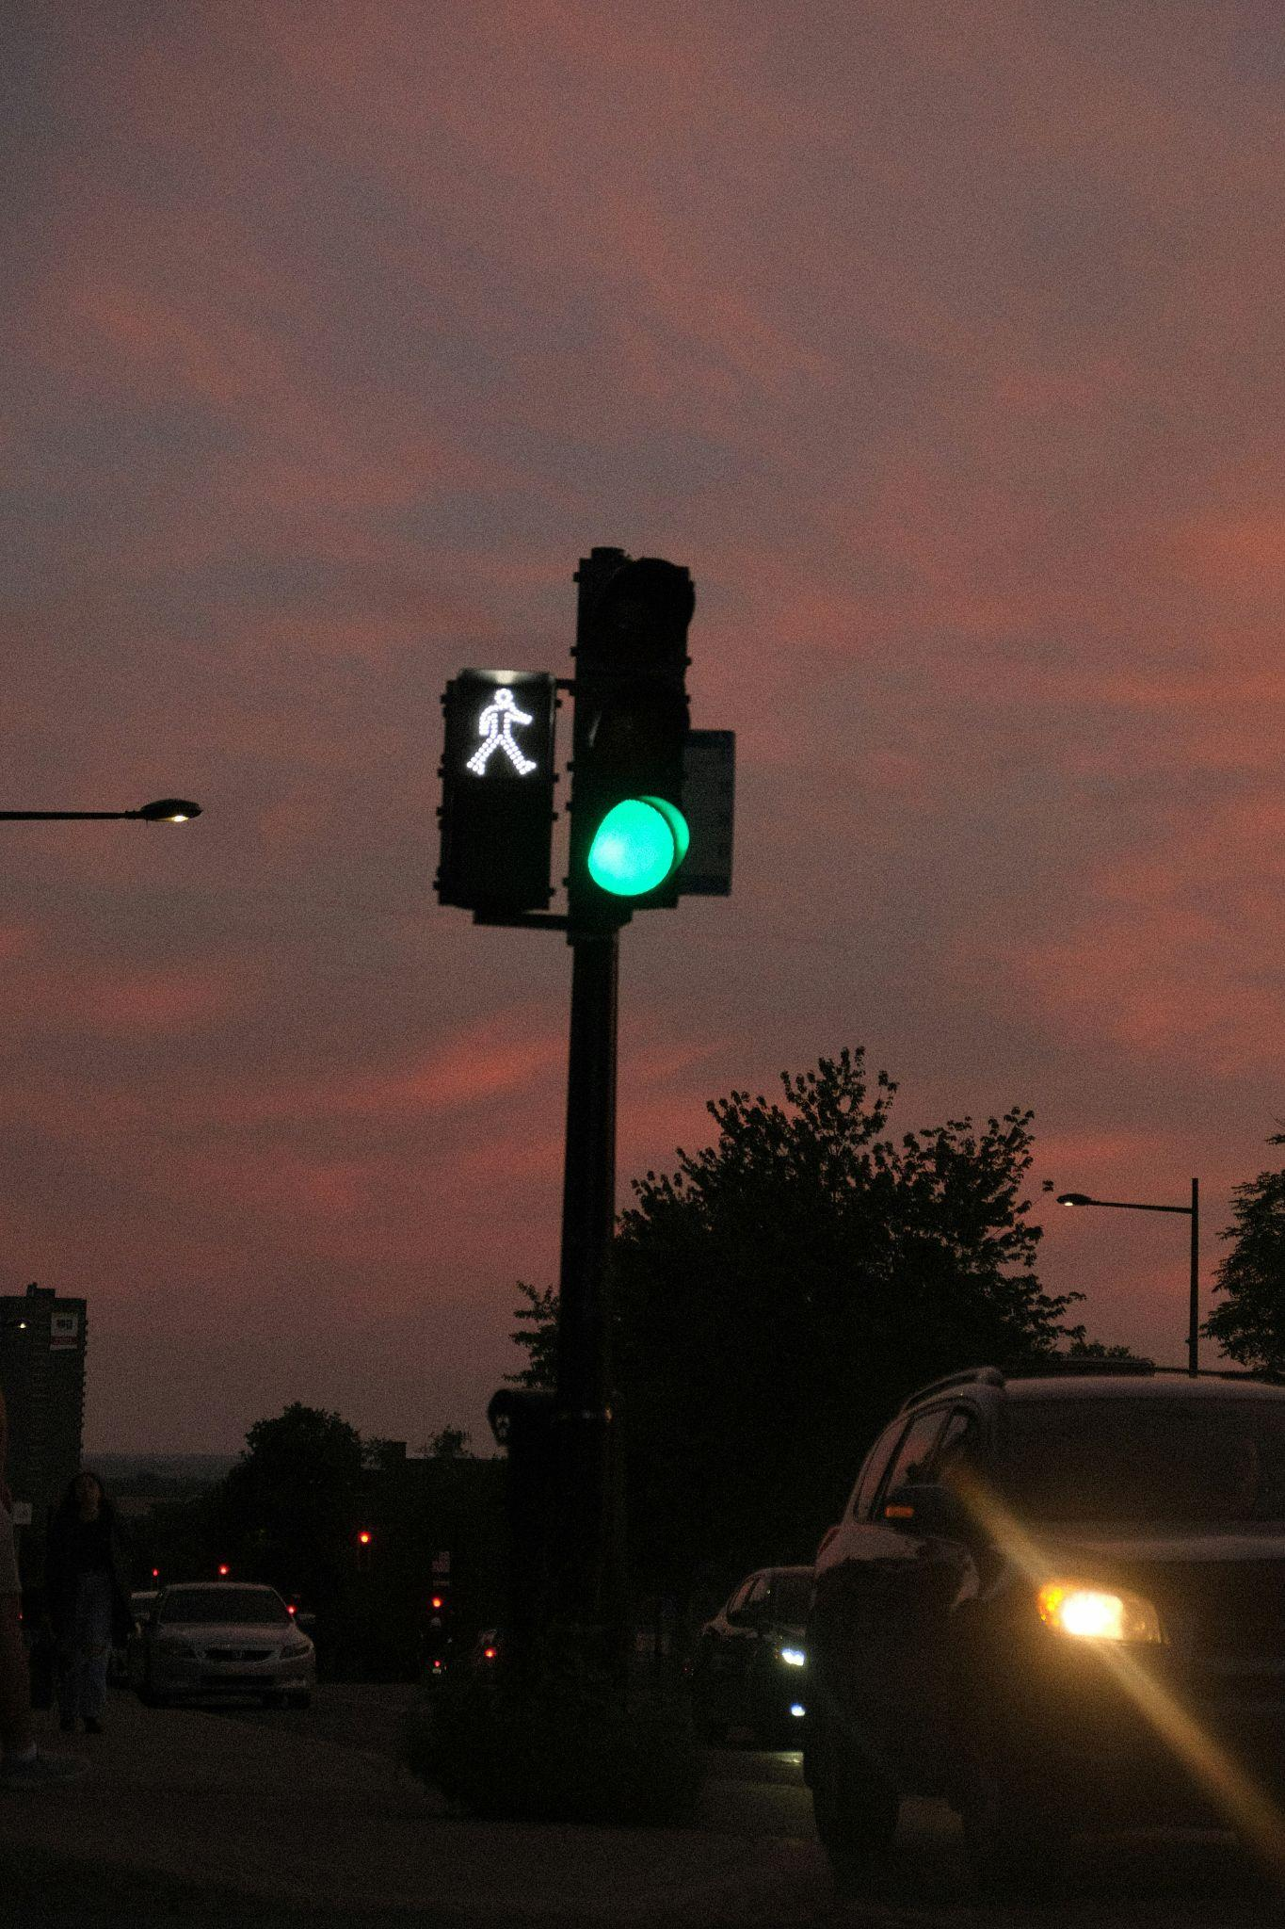
<VERSE 1>
Jeremiah 17:9 The heart is deceitful, sick
Romans 3:10 No one righteous
Romans 3:23 All have sinned and fall short of God’s glory
Isaiah 59:15 The Lord saw that there was no justice; He was offended
Hearts
2026

Slide 3
<CHORUS>
Psalm 51:10 Create in me a clean heart, O God
Psalm 51:12 Grant me a willing spirit
Micah 7:7 I will look to the Lord. I will wait for the God of my salvation. My God will hear me
Hearts
2026
Month Year

Slide 4
<VERSE 2>
1 Samuel 16:7 People look at the outward appearance, but the Lord looks at the heart
Jeremiah 29:13 Seek Me and find Me; when you search for Me with all your heart
Micah 7:7 Therefore, I will look to the Lord
Hearts
2026
Month Year

Slide 5
<CHORUS>
Psalm 51:10 Create in me a clean heart, O God
Psalm 51:12 Grant me a willing spirit
Micah 7:7 I will look to the Lord. I will wait for the God of my salvation. My God will hear me
Psalm 51:10 Create in me a clean heart, O God, renew a steadfast spirit within me
Hearts
2026
Month Year

Slide 6
<CHORUS>
Psalm 51:10 Create in me a clean heart, O God
Psalm 51:12 Grant me a willing spirit
Micah 7:7 I will look to the Lord. I will wait for the God of my salvation. My God will hear me
Psalm 51:10 Create in me a clean heart, O God
Micah 7:7 My God will hear me
Hearts
2026
Month Year

Slide 7
©2026 Awake and Renew. All Rights Reserved. This resource is protected by copyright and provided subject to the terms of use established by the organization. Scripture quotations are curated from various faithful versions of the Holy Bible. For current licensing, distribution, and usage permissions, please visit awakeandrenew.org/license. For a comprehensive list of translation copyrights, please visit awakeandrenew.org/copyright.
Hearts
2026
Month Year

